Slide 1


Adenrele Ishola
https://github.com/Saishola/IBM-Data-Science-Capstone
03/30/2023

Slide 2

Outline
Executive Summary
Introduction
Methodology
Results
Conclusion
Appendix

Slide 3
Executive Summary
The data used for this research was extracted from SpaceX API and SpaceX Wikipedia page using Web scraping techniques. The extracted data was cleaned and classified into successful/fail outcomes using the data wrangling technique. SQL, visualization techniques, folium maps, and dashboards were utilized for data exploration to obtain the relevant features needed to create machine learning models. One hot encoding converted all the categorical variables to binary, standardization technique to rescale feature values and GridSearchCV helped find the best parameters for the machine learning models.
Support Vector Machines, Logistic Regression, Decision Tree, and K Nearest Neighbors are the machine learning models investigated for predicting the landing outcome. Of the four models, the Decision tree underperformed with 77.78% accuracy while others have the same accuracy of 83.33%.

Slide 4
Introduction
Background
Comparison between the cost of rocket launches between companies.
The reason why Space X has the best pricing ($62 million vs. $165 million)
The ability to recover and reuse part of the first stage reduces the rocket launch cost.
The project aims to develop a model to predict the success rate of the first stage of rocket launching.
Problems
Factors that determine if the rocket will land successfully
Space Y wants to develop a model to predict the success of stage 1 recovery

Slide 5
Methodology
Data collection methodology:
Data was extracted from SpaceX API and SpaceX Wikipedia page
Perform data wrangling
Classified true landings as successful and unsuccessful otherwise.
Used one-hot encoding on categorical features
Perform exploratory data analysis (EDA) using visualization and SQL
Perform interactive visual analytics using Folium and Plotly Dash
Perform predictive analysis using classification models
Utilized GridSearchCV to select the best model parameters

Slide 6
Data Collection
The data collection process involves:
API requests from Space X API
Web scrapping data from Space X Wikipedia

Slide 7
Data Collection – SpaceX API
Request Space X APIs
Convert the response to JSON file
Convert JSON to dataframe with json_normalize
Create dictionary of relevant data
Clean and impute missing data
Select only Falcon 9 launches
Cast Dictionary to dataframe
GitHub URL
https://github.com/Saishola/IBM-Data-Science-Capstone/blob/main/Data%20Collection%20API.ipynb

Slide 8
Data Collection – Web Scraping
Request Wikipedia html
Utilize BeautifulSoup Parser
Find Launch Info table
Create dictionary of relevant data
Cast Dictionary to dataFrame
Extract data to the dictionary by iteration
GitHub URL
https://github.com/Saishola/IBM-Data-Science-Capstone/blob/main/Data%20Collection%20with%20Web%20Scraping.ipynb

Slide 9
Data Wrangling
Created the training labels by encoding successful landing outcomes as 1 and failures as 0.
Calculate the number of launches at each site and the number of occurrences of each orbit.
Created landing outcome label from outcome column and exported the results to CSV file.
https://github.com/Saishola/IBM-Data-Science-Capstone/blob/main/Data%20Wrangling.ipynb

Slide 10
EDA with Data Visualization
Data visualization plots were used to visualize the relationships between features.
Flight Number, Payload Mass, Launch Site, Orbit, Class and Year were the variables explored.
Scatter plots, line charts, and bar plots were the plots used to visualize the relationships between variables.
https://github.com/Saishola/IBM-Data-Science-Capstone/blob/main/EDA%20with%20Data%20Visualization.ipynb

Slide 11
EDA with SQL
The dataset was loaded into IBM DB2 database
SQL Python integration was utilized to query the database.
We queried information about the Launch site names, mission outcomes, various payload sizes and landing outcomes
https://github.com/Saishola/IBM-Data-Science-Capstone/blob/main/EDA%20with%20SQL.ipynb

Slide 12
Build an Interactive Map with Folium
Markers were used to mark Launch Sites.
The markers indicate the success or failure of launches for each site on the folium map
It makes us understand why launch sites are located where they are.
We can also visualize the proximity of launch sites to railways, highways, and coastlines
https://github.com/Saishola/IBM-Data-Science-Capstone/blob/main/Interactive%20Visual%20Analytics%20with%20Folium.ipynb

Slide 13
Build a Dashboard with Plotly Dash
Plotly dash was utilized to create a dashboard
The dashboard contains a pie chart and a scattered plot.
We plotted a pie chart to show the total launches by cites
We plotted the scatter plot to show the relationship between Payload mass and sites.
https://github.com/Saishola/IBM-Data-Science-Capstone/blob/main/spacex_dash_app.py

Slide 14
Predictive Analysis (Classification)
Load data using numpy and pandas
Split the data into training and testing data
StandardScaler to scale the features
Select optimal parameters with GridSearchCV
Barplot to compare the models’ performance
Evaluate the models’ performance
https://github.com/Saishola/IBM-Data-Science-Capstone/blob/main/Machine%20Learning%20Prediction.ipynb

Slide 15
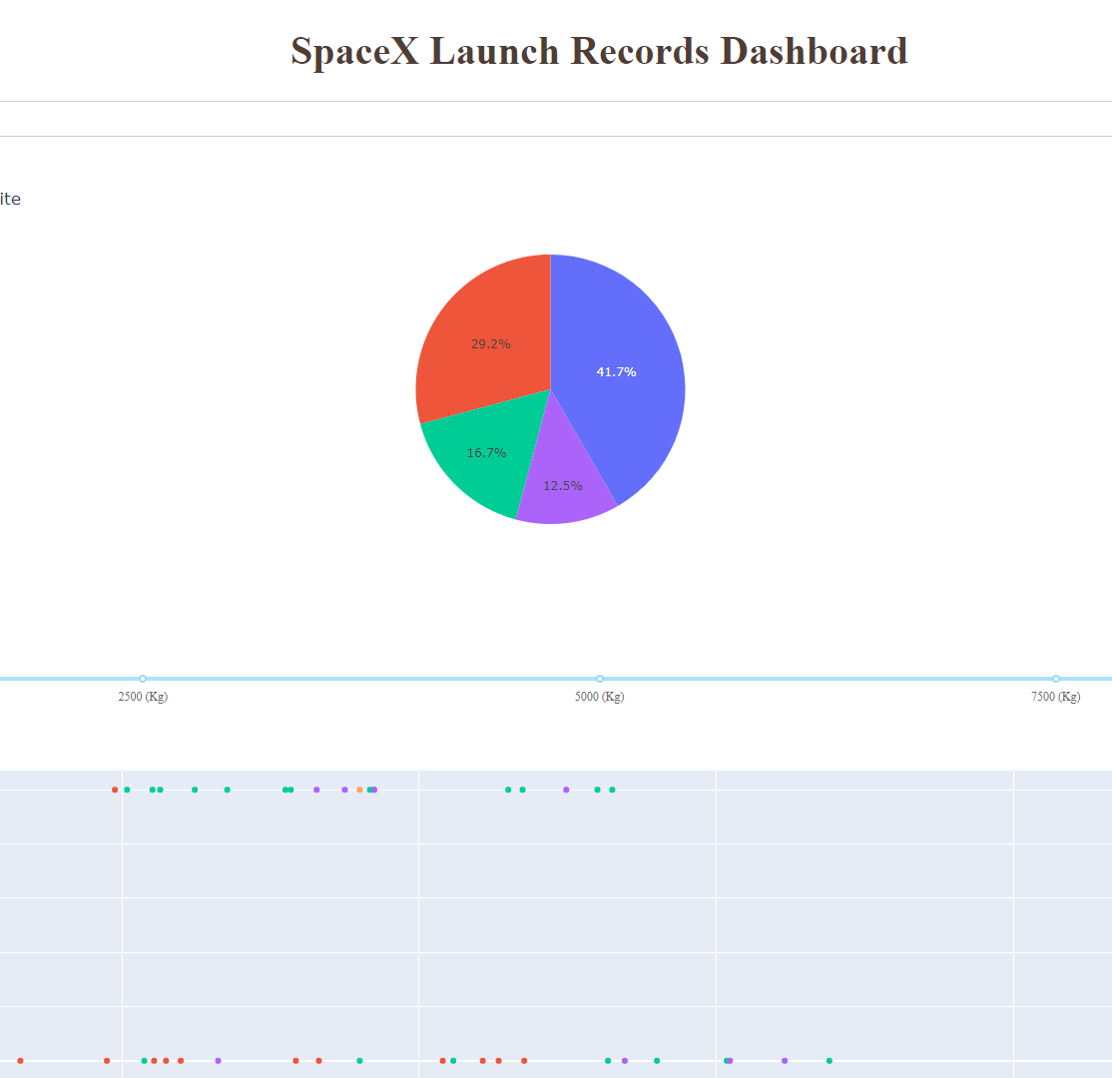
Results
Preview of the Plotly dashboard

Slide 16

Section 2

Slide 17
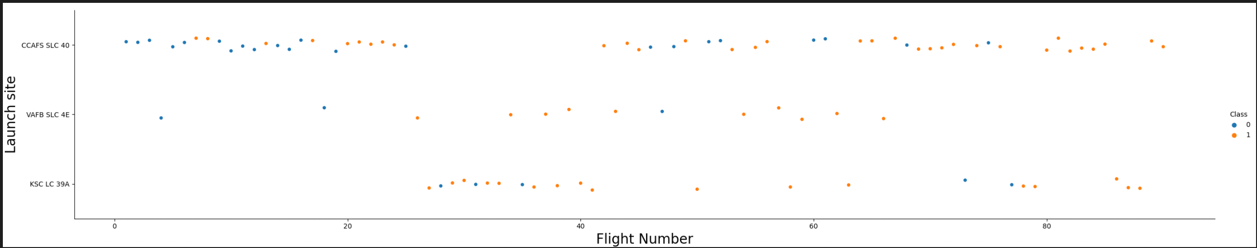
Flight Number vs. Launch Site
The graph suggests an increase in the success rate as flight number increases
CCAFS seems to be the major launch site.
Orange indicates successful launch; Blue signifies the unsuccessful launch

Slide 18
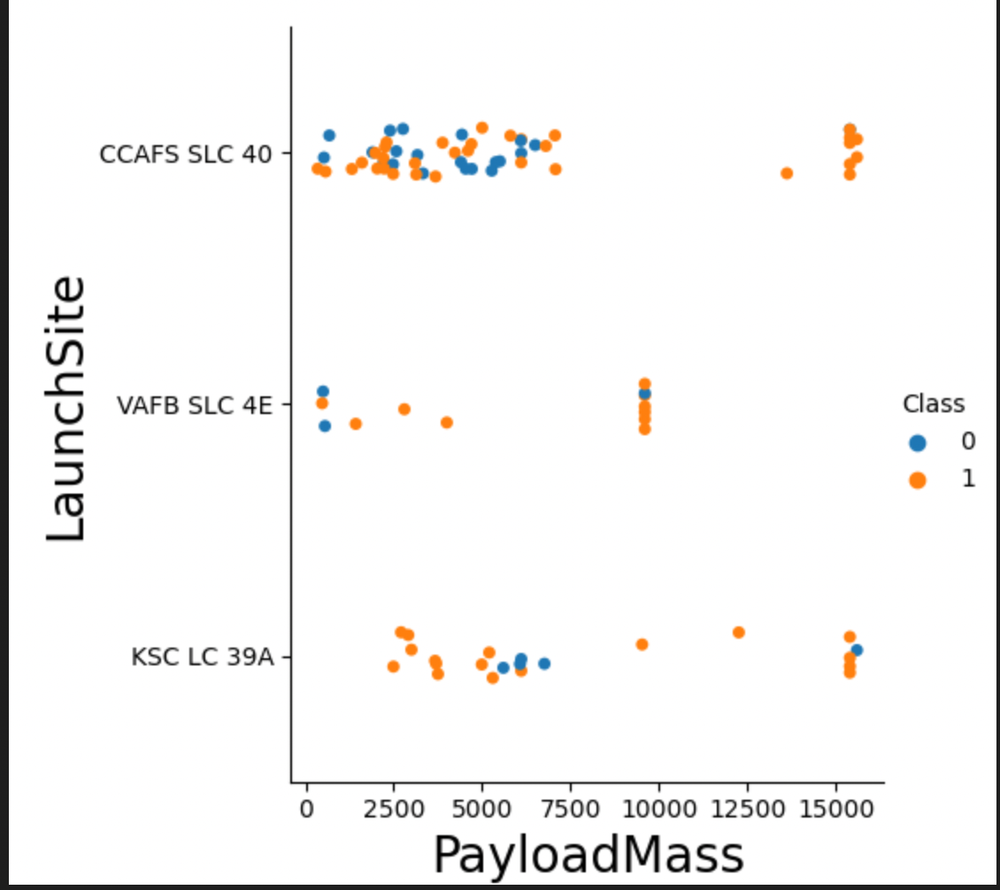
Payload vs. Launch Site
Orange indicates successful launch; Blue signifies the unsuccessful launch
Most payload mass appears to fall between 0 – 6000 kg.

Slide 19
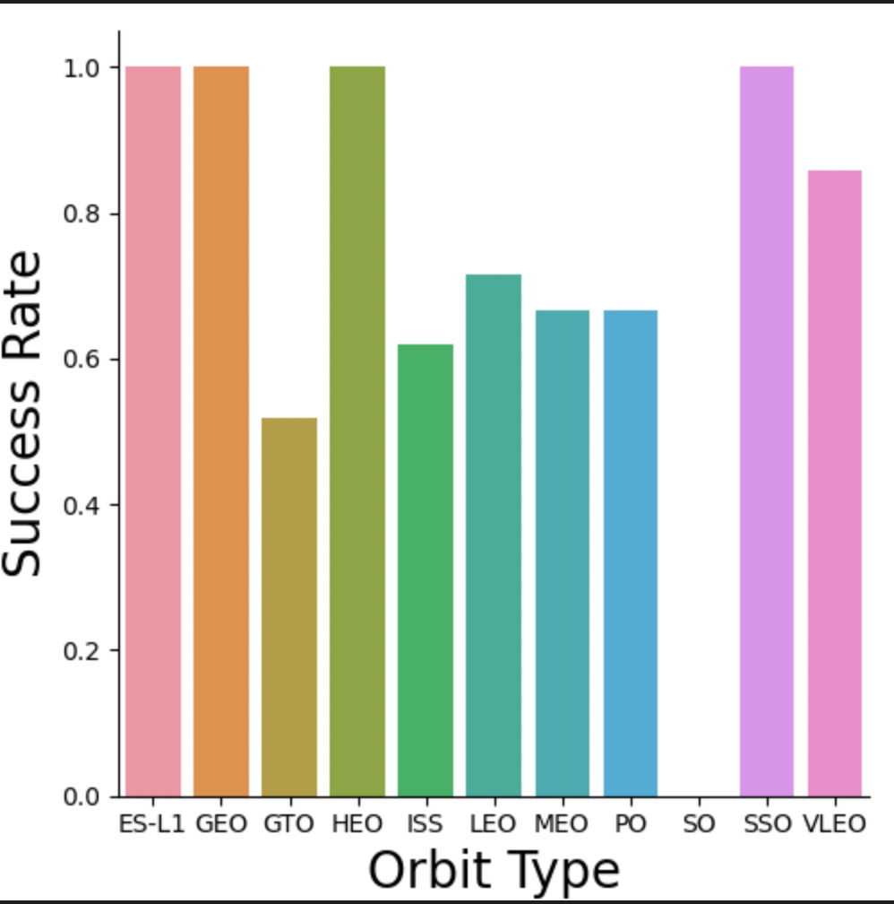
Success Rate vs. Orbit Type

Slide 20
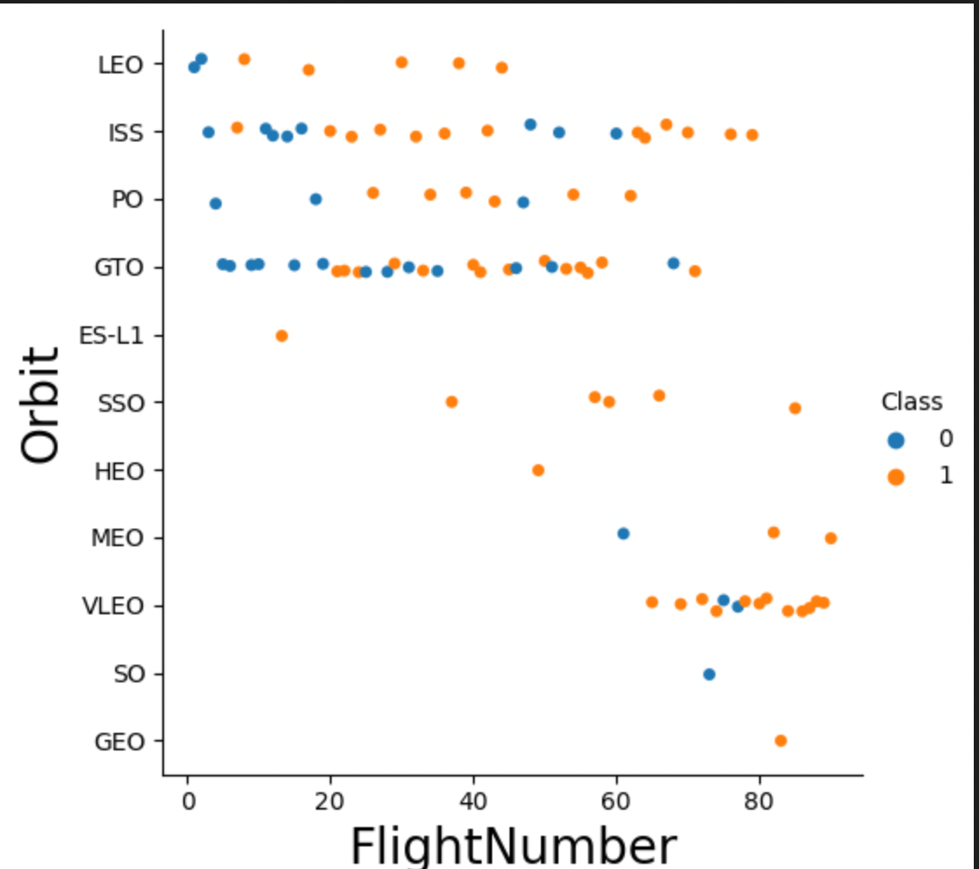
Flight Number vs. Orbit Type
Orange indicates successful launch; Blue signifies the unsuccessful launch

Slide 21
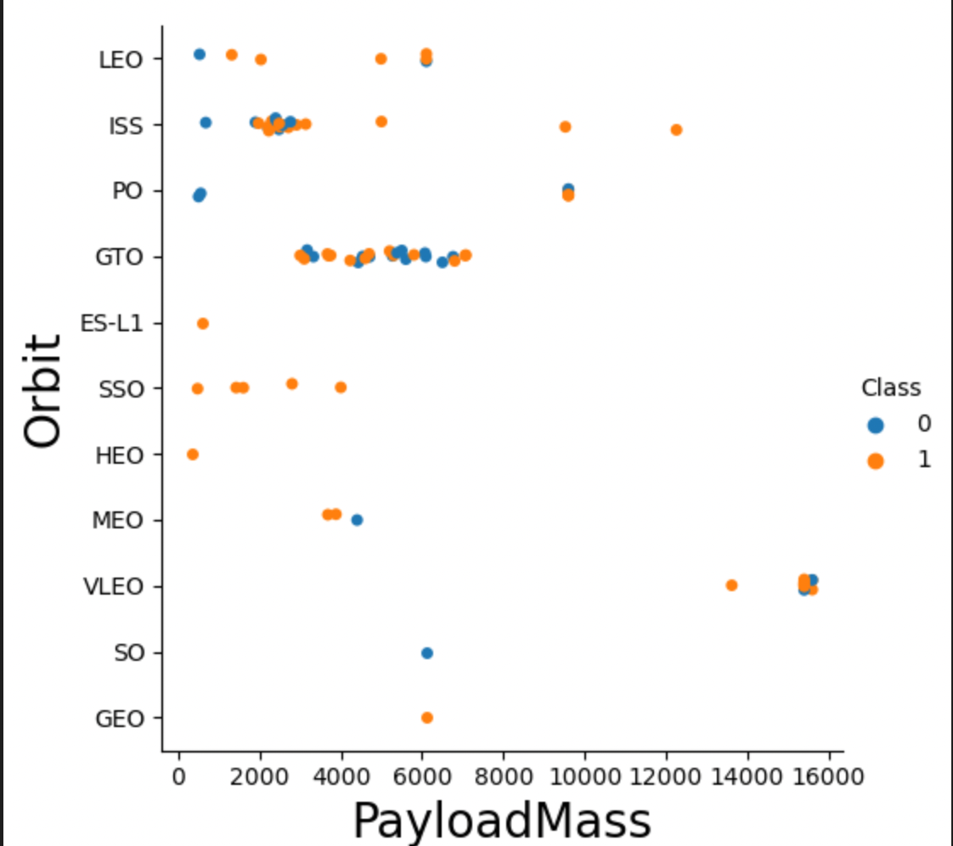
Payload vs. Orbit Type
Payload mass appears to have a correlation with orbit.
Orange indicates successful launch; Blue signifies the unsuccessful launch

Slide 22
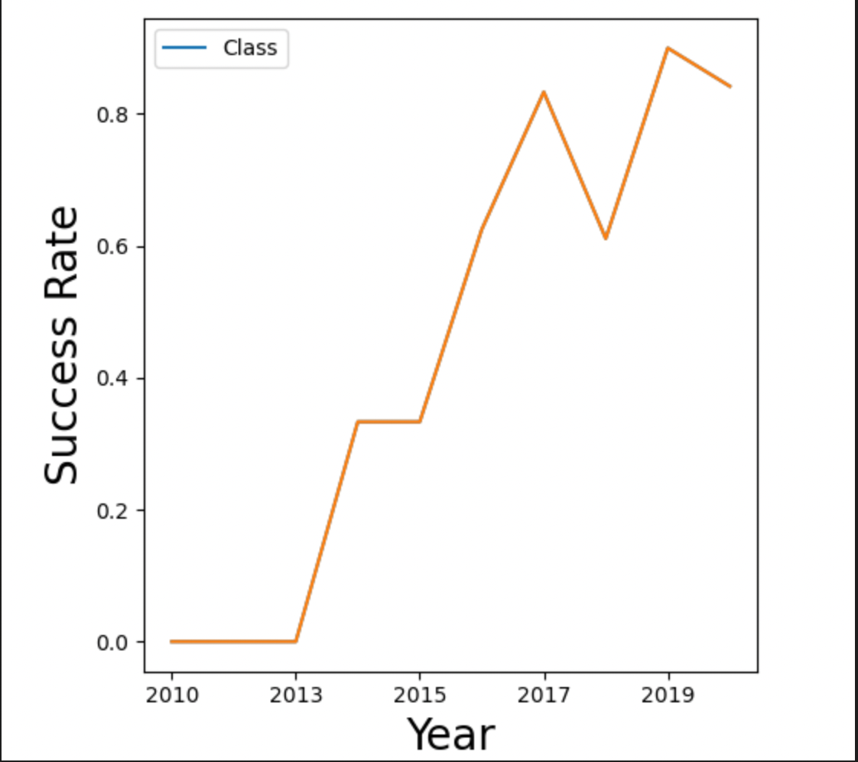
Launch Success Yearly Trend
The success rate is on an increasing trend.

Slide 23
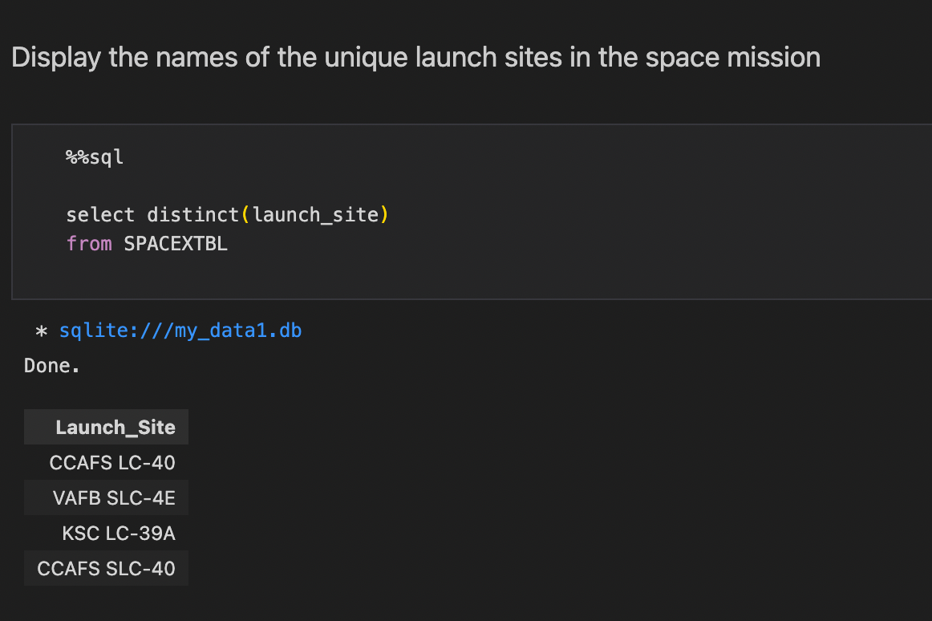
All Launch Site Names
Keyword DISTINCT was used to show only unique launch sites.

Slide 24
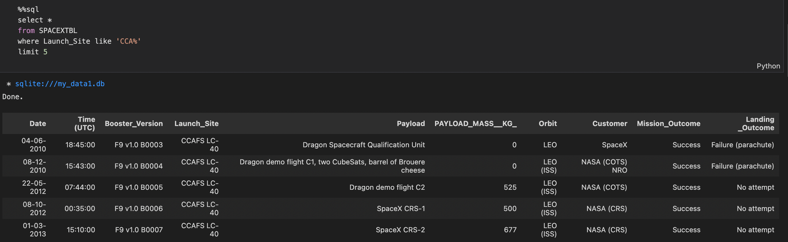
Launch Site Names Begin with 'CCA'
The query shows the first entries in the database with Launch site name beginning with ‘CCA

Slide 25
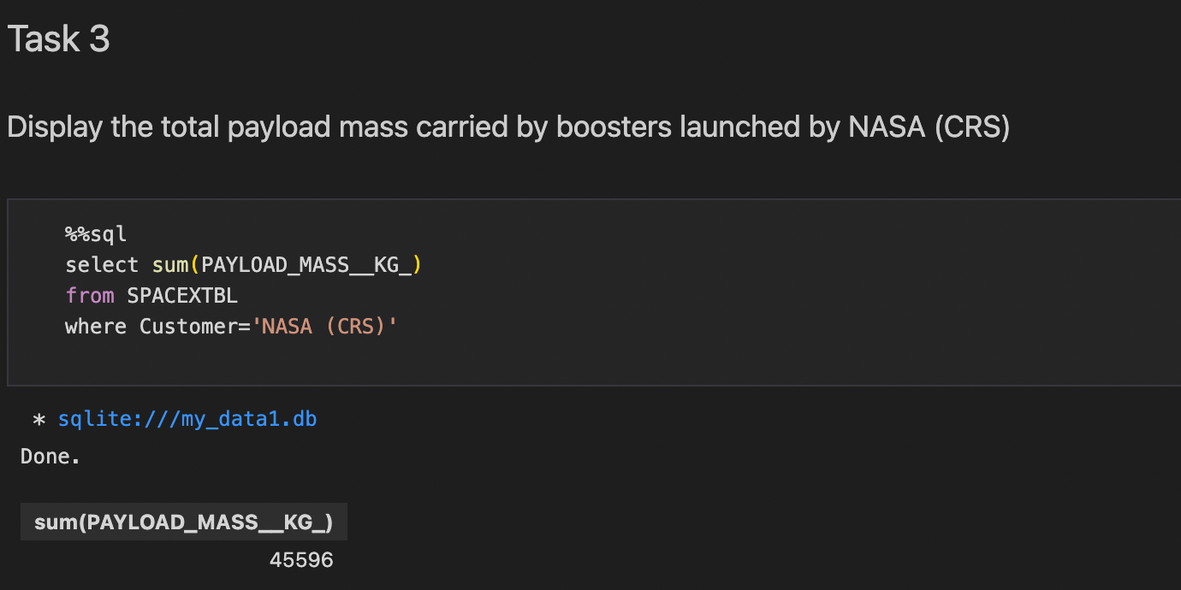
Total Payload Mass
The query sums the total payload mass in kg

Slide 26
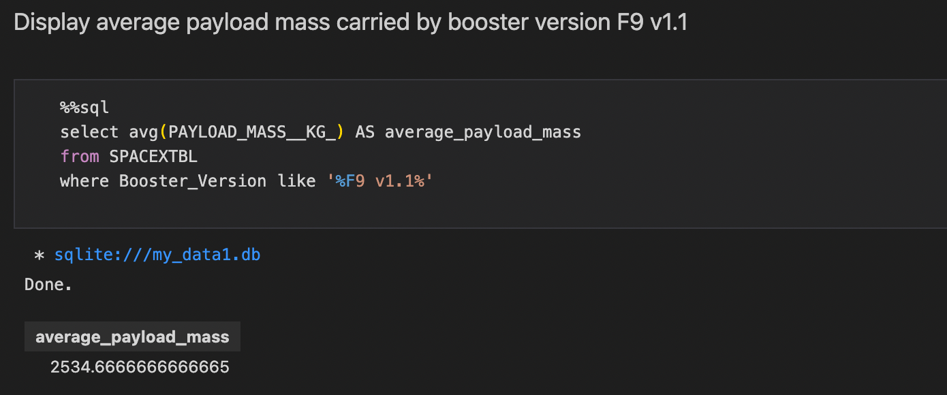
Average Payload Mass by F9 v1.1
This query calculates the average payload mass that used booster version F9 v1.1

Slide 27
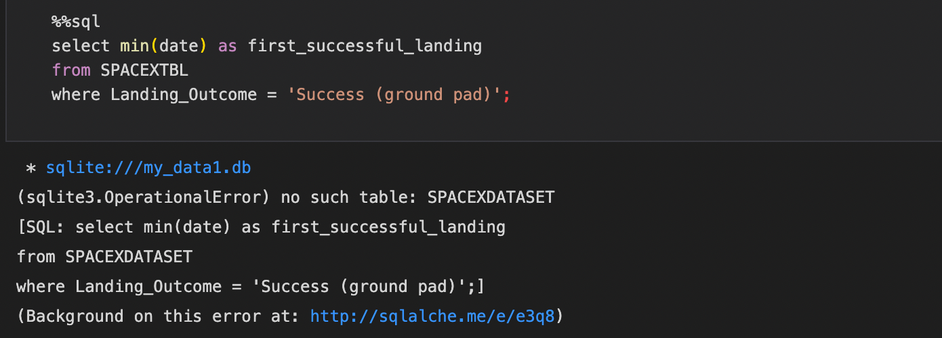
First Successful Ground Landing Date
This query returns the successful ground pad landing date

Slide 28
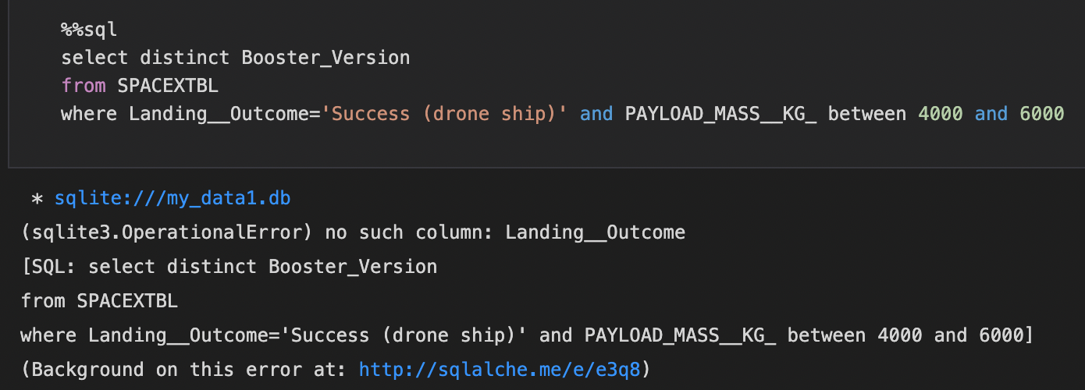
Successful Drone Ship Landing with Payload between 4000 and 6000
This query shows the booster versions that had successful drone ship landings and a payload mass between 4000 and 6000.

Slide 29
Total Number of Successful and Failure Mission Outcomes
SpaceX has its mission outcome 99% of the time

Slide 30
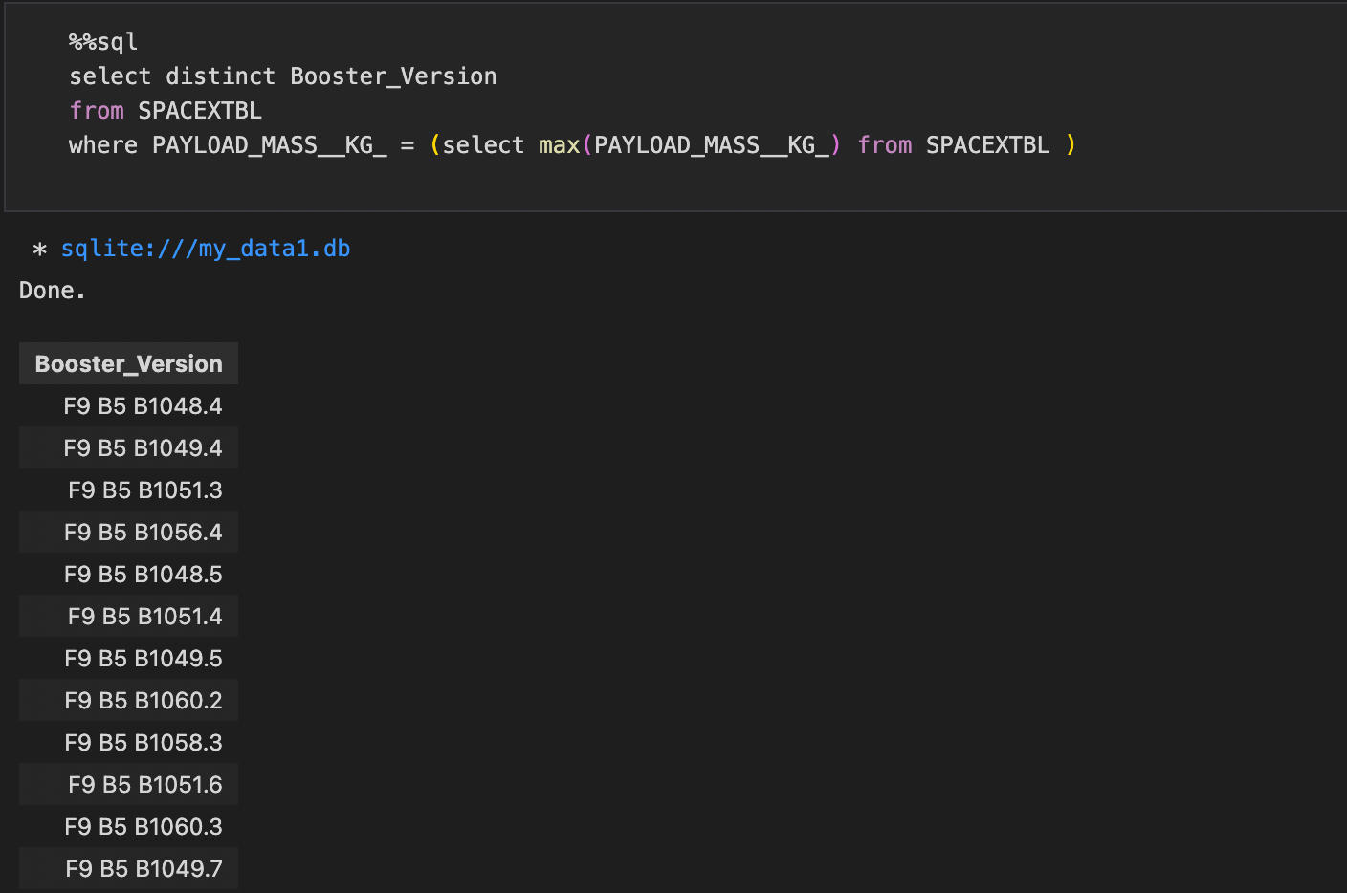
Boosters Carried Maximum Payload
This query returns the booster versions that has the highest payload mass of 15600 kg

Slide 31
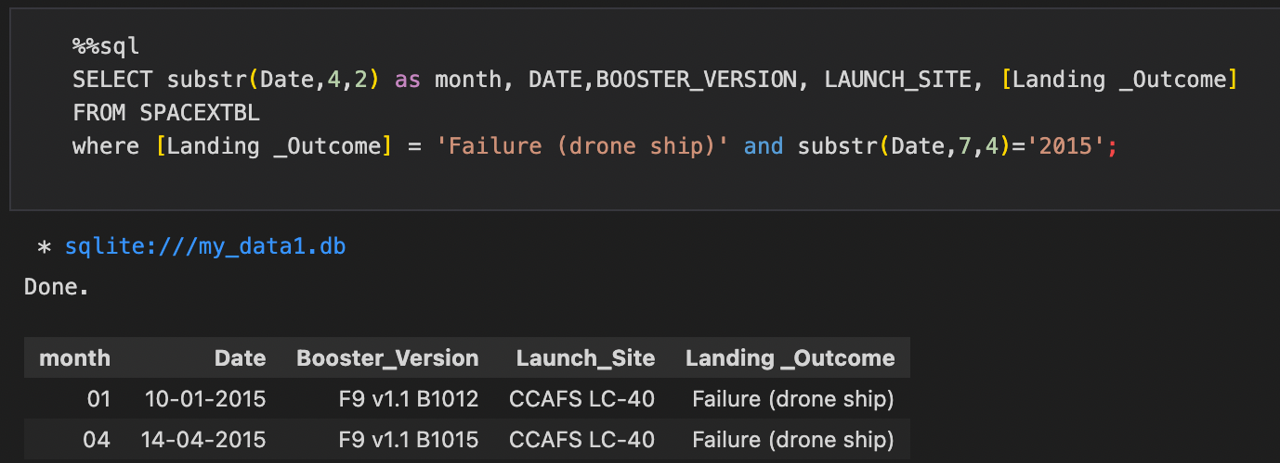
2015 Launch Records
The query returns the details of failed stage 1 landing on a drone ship in 2015

Slide 32
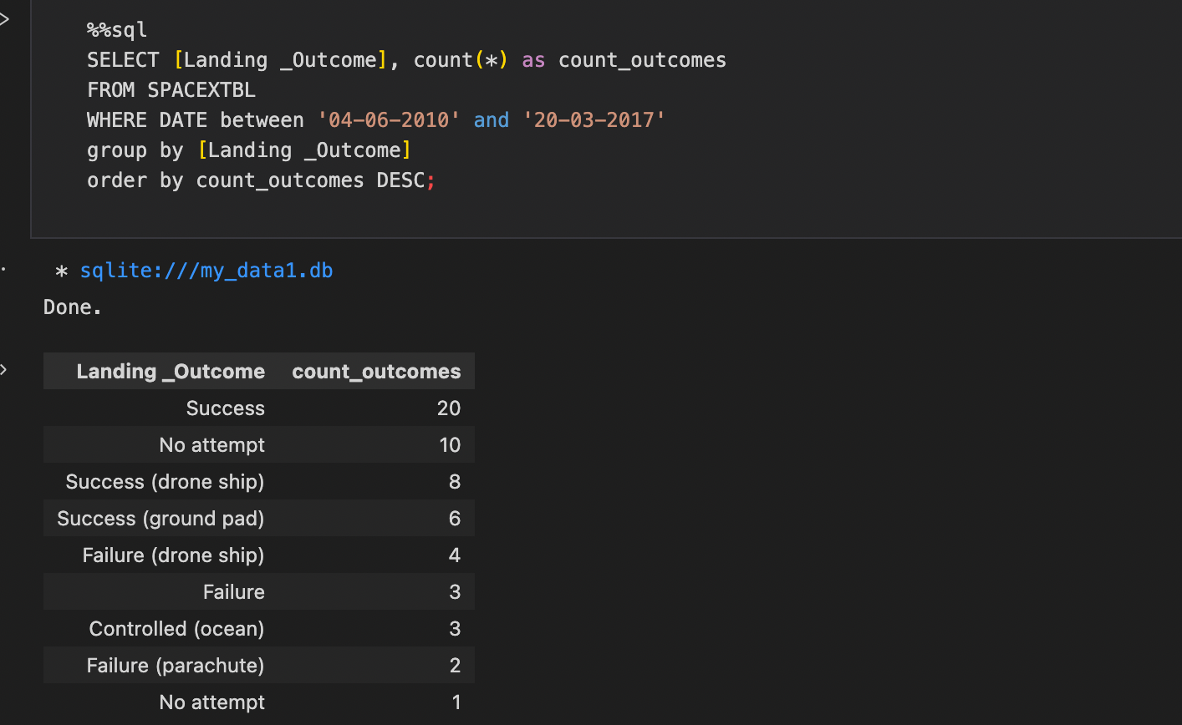
Rank Landing Outcomes Between 2010-06-04 and 2017-03-20

Slide 33

Section 3

Slide 34
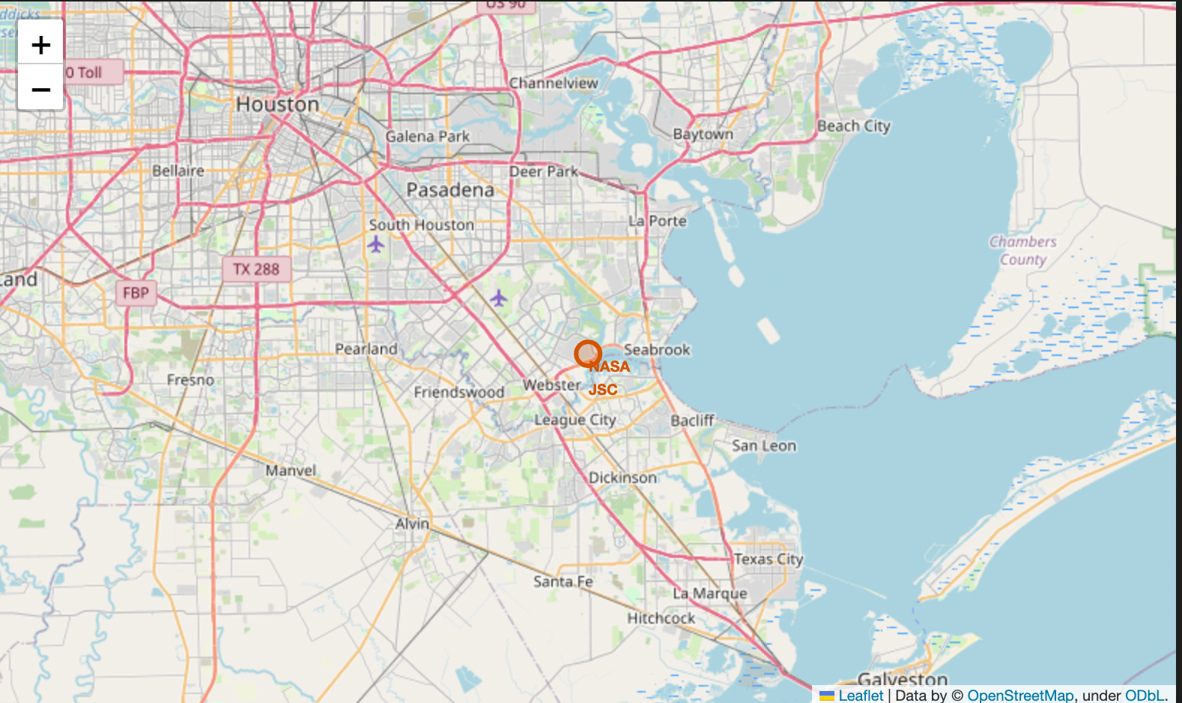
Launch Site Locations
The map shows the launch sites are closer to the ocean.

Slide 35

Color-coded Launch Markers

Slide 36



Key Location Proximities
The images show the proximity of the launch sites to major landmarks like railways

Slide 37

Section 4

Slide 38


Successful Launches Across Launch Sites
The chart shows the percentage of successful landings across all launch sites. CCAFS SLC has the smallest share of successful landings.

Slide 39

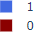
Highest Success Rate Launch Site
KSC LC-39A has the highest success rate with 10 successful landings and 3 failed landings.

Slide 40

Payload Mass vs. Success vs. Booster Version Category

Slide 41

Section 5

Slide 42
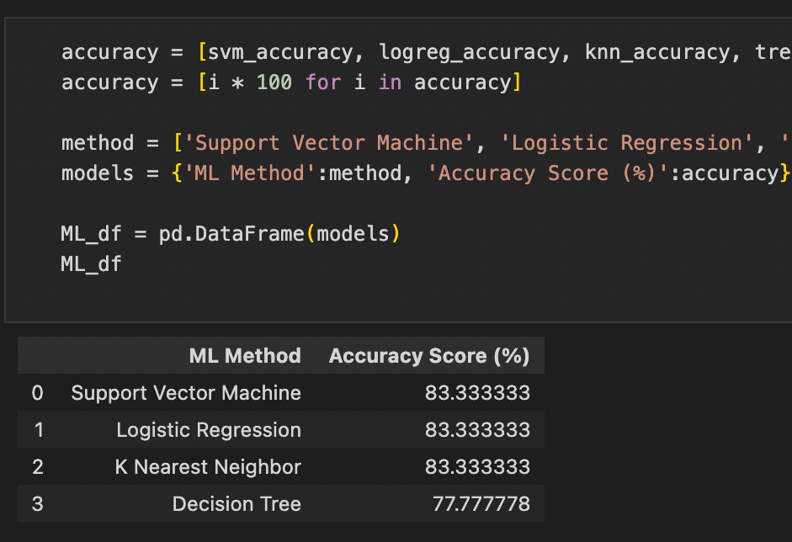
Classification Accuracy
Decision tree has the least classification accuracy

Slide 43
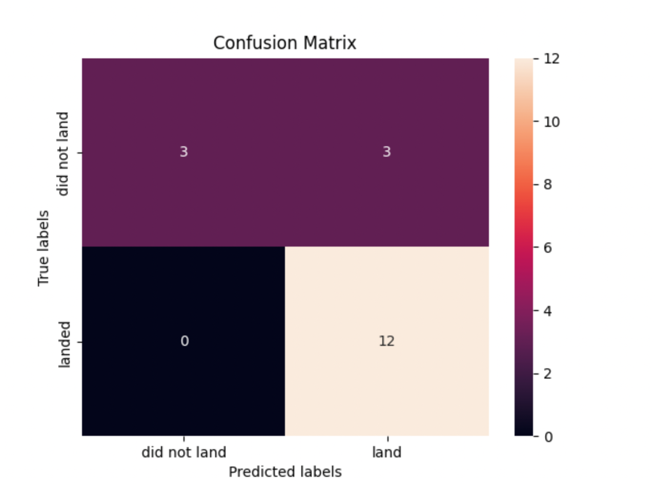
Confusion Matrix
There were 12 successful landings when the true label was successful landing
Only 3 samples were misclassified

Slide 44
Conclusions
Space Y tasks us with developing a machine-learning model that would make them competitive with Space X.
The aim is to predict when Stage 1 will successfully land to save money.
Data were collected from public SpaceX API and web scraping SpaceX Wikipedia page
We created a dashboard for visualization and interaction with the data
The decision tree has the least classification accuracy of the four machine-learning models
More data should be collected to better determine the best machine learning model and improve accuracy

Slide 45
Appendix
GitHub repository URL:
https://github.com/Saishola/IBM-Data-Science-Capstone
Instructors:
Instructors: Rav Ahuja, Alex Aklson, Aije Egwaikhide, Svetlana Levitan, Romeo Kienzler, Polong Lin, Joseph Santarcangelo, Azim Hirjani, Hima Vasudevan, Saishruthi Swaminathan, Saeed Aghabozorgi, Yan Luo
Special Thanks to All Instructors:
https://www.coursera.org/professional-certificates/ibm-data-science?#instructors

Slide 46


